Slide 1

MAP – Model Driven APpproach
An Overview
Kinetium Inc.
Notes:
Structure
A little more method overview
Add “Basic Modeling”: objects + actions → info + behavior models (without any diagrams??)
Add fully-worked, tiny case study as posters
Include notation summaries
Main structure should reflect new method documentation

Slide 2
Outline
Introduction to MAP: What it is, Process and Artifacts
Models, Architecture, and Objects
Goals and Domain Model
Current State Architecture
Target State Architecture
Migration Plan
Project Management

Slide 3


What is MAP?
MAP – Model-Driven Approach
MAP is a systematic approach to architect, plan, develop, and evolve software systems
  Clearly separated viewpoints and models to design or analyze an architecture
1. Business Driven
understand business goals, process
and vocabulary first, relate disparate views
2. Traceability
bridge Business and IT
precise shared vocabulary
critical business questions early
5. Reuse Process
develop for reuse
develop with reuse
reuse business models
… and architectures
… and implementations
4. Consistent Architecture
blueprint for consistency
principles, patterns,
interfaces, platforms, …
standards for
interoperability
3. Design and Assemble Pluggable Components
federated components not monolithic systems
clear interfaces and responsibilities
reusable and maintainable building blocks
Builds upon best practice and industry standards for architecture: UML, EDOC, RM-ODP, Catalysis, Simple Components, RUP, …

Slide 4
What Questions Does MAp Ask?
What are the properties of the box visible at its boundary?
functionality: services offered and
required, events handled,
information handled
others: volumes, performance,
location, security, tech platform
What is the bigger
goal being achieved outside?
How is our box combined with other parts to solve it?
Are there better approaches?
What is the boundary of the “box”
we are describing?
Workers
Policies
Our Box
Resources
What internal “boxes” can be combined to do the job?
Existing? New?
How to partition behavior and information responsibility to meet end-to-end needs?
What are the properties of each internal box?
functionality: services offered and
required, events handled,
information handled
others: volumes, performance,
location, security, tech platform
What consistent principles, patterns, or styles guide our design and are shared across components?
How should we document all these?

Slide 5

Goal is not the same as System Specification
Goal
Projector
Specification
Goals are typically 1, 2, or more levels “removed” from the system
  Goal observes certain things in the “problem domain” to control certain other things
Target system + other elements + domain properties needed to meet the goal
  Target system = projector
  Other elements = screen, cables, laptop, speaker, audience, room
  Domain properties = audience co-located with speaker, room size adequate, …

Slide 6
The MAP questions
What is the goal being achieved outside? What does it control and observe? How is our box combined with other parts to solve it?
Are there better approaches?
Goal
What is the boundary of our “box”?
What are the properties of all solution components & connectors to meet goal?
Projector
Specification
What are the properties of the box visible at its boundary?
What consistent principles, patterns, or styles guide our design and are shared across components?
What internal “boxes” can be combined to do the job?
Existing? New?
How to partition behavior and information responsibility to meet end-to-end needs?
What are the properties of each internal box?
functionality: services offered and
required, events handled,
information handled
others: volumes, performance,
location, security, tech platform

Slide 7
Where are “Requirements” ??
Goal
Requirements?
Projector
Specification
“Requirements” is frequently used to cover a variety of different things
Most frequently used for “Specification” of one system
MAp recommendation: be clear which one you mean

Slide 8
Exercise 1

Slide 9
Architecture in Context
What architecture styles better meet goals?
Architecture Styles
Knowledge
Patterns
Principles
Refinements
Transformations
Goals
Objectives
Problems
Needs
Requirements
Constraints
the “real” problem
possible solution
solution approaches
lessons learned
Architecture
How best to deploy the changes?
Domain/System
Running
Operating
In the Real-World
implement, deploy, operate
conforms to, reverse engineer, adaptive feedback
How well is the system meeting goals?
The architecture of a system is a key determinant of
how well a running system will meet business goals

Slide 10
Two Aspects of the MAP Framework
Formal Architecture Framework
Goals
Viewpoints
Concerns
Models
Refinement
Architecture Styles
Process Pragmatics
Routes: Roadmap, Construction, …
Different Entry Points
Iterative and Incremental
List, Draft, or Dressed Templates
Guidelines

Slide 11
MAp Viewpoints
Information supports goals, process
Need shared domain
vocabulary
Process supports goals
Domain / Biz
Architecture
Need shared domain
vocabulary
Goal
1
sub-goal
sub-goal
Outside
Domain: Information
Goals
Biz.Process
Goals – success criteria
Traceability
Black box assembly includes S
Black-boxes use cases and info
models support business model
Black box Assembly (including S)
Three primary viewpoints
Component Architecture
Black box view (of S)
1
S
1
2
S
E
D
S
Boundary
Black-box specification (of S)
4
Architecture Styles: Principles, Patterns, Guidelines, Rules, Transforms
S: Information
S: Behavior
3
White box view of S
sub-component s1…s3
Black box view of S
Styles across viewpoints, projects:
workflow partitioning style
MQ series configuration style
Black-box behavior and info model
partitioned into sub-components
1
2
S
S
Component Architecture
White box view (of S)
s1
s2
Inside
s2
3b
s1
s3
3a
s3
4
Information
Behavior
Each sub-component could be existing separately specified generic black box, or new spec for next level of drill-down.

Slide 12
What Questions Does MAp Ask?
What are the properties of the box visible at its boundary?
functionality: services offered and
required, events handled,
information handled
others: volumes, performance,
location, security, tech platform
What is the bigger
goal being achieved outside?
How is our box combined with other parts to solve it?
Are there better approaches?
What is the boundary of the “box”
we are describing?
Performance
Technology
Security
Functionality
Our Box
Resources
Workers
Policies
What internal “boxes” can be combined to do the job?
Existing? New?
How to partition behavior and information responsibility to meet end-to-end needs?
What are the properties of each internal box?
functionality: services offered and
required, events handled,
information handled
others: volumes, performance,
location, security, tech platform
What consistent principles, patterns, or styles guide our design and are shared across components?
How should we document all these?

Slide 13
Multiple Concerns, Styles, across Viewpoints
Module: build-time structure of software units including sources and tools
Location: deployment, location & connectivity: people, hardware, software
Technical: technical and platform realizations of components, ports, connectors
Concerns
Performance: throughput, response time, latency, data volumes, loads
Security: who can and cannot do what and to whom
Logical Functionality: what actions with what information and what triggers
1. Business Architecture
Business perspective on the problem or concern, including goals, activities, interactions, and information.
Outside
Architecture Styles: Principles, Patterns, Guidelines, Rules
Viewpoint
2. component architecture
– Black Box
Describe a large grained software component as a black box, with its behavior and information responsibility to others in its environment, for any aspect that is externally visible.
Boundary
3. component architecture
- White Box
Design the “insides” of a black box component as a collection of connected sub-components, each a black-box, and decide how they collaborate to fulfill black box responsibilities.
Inside
Address all relevant concerns early in the process and in the appropriate viewpoint
Notes:
REVISIONS:
Add summary of UML diagrams used.

Slide 14
Technical Architecture – Complex “Overlay” at any Level
White-Box: Logical Components and Connectors
A:1
A:2
C
C
A:3b
A:3a
A:4
Information
Behavior
Technical platforms to run components and to communicate via connectors
Technical: Component
Technical: Connector
platforms,
configurations
thick client and db
VB to J2EE via messaging
White-Box: Technical Realization of Components and Connectors

Slide 15
Architecture Principles and Styles
Architecture styles define patterns of preferred or allowed architectures
One common form: Wherever you have … solve it by …
Very wide spectrum in (and across) all viewpoints
  Earliest point of data capture
    Wherever any process needs some information at multiple points …
    Capture the information at the first opportunity in process. Never require it again.
  MQ Series Configuration Style for Co-located Queues
    Wherever co-located components need a messaging connector …
    For a source S of events and a destination D that will be co-located on a single machine, use an MQ Series queue named <S><D><…>, configured as <….>, and set up the S and D ends of the queue as <….>
  XML encoding styles
    Use nested entities for …; use attributes for …; compress names as follows …
  Integration styles: point-to-point, desktop, gateway, …

Slide 16
Architecture Styles can Span Viewpoints, Concerns
Architecture Styles
Module: build-time structure of software units including sources and tools
Location: deployment, location & connectivity: people, hardware, software, devices
Technical: technical and platform realizations of components, ports, connectors
Concerns
Performance: throughput, response time, latency, data volumes, loads
Security: who can and cannot do what and to whom
Business
Architecture Style
Logical Functionality: what actions with what information and what triggers
1. Business Architecture
Business perspective on the problem or concern, including goals, activities, interactions, and information.
Every business process must
do earlier point of data capture
Outside
Viewpoint
2. component architecture
– Black Box
Describe a large grained software component as a black box, with its behavior and information responsibility to others in its environment, for any aspect that is externally visible.
Boundary
Every web UI
3. component architecture
- White Box
Design the “insides” of a black box component as a collection of connected sub-components, each a black-box, and decide how they collaborate to fulfill black box responsibilities.
White-box Architecture Style
Inside
has this logical structure …
Each style can be about just business, or white-box logical, or …
… or about correspondence or even transformations across viewpoints
Notes:
REVISIONS:
Add summary of UML diagrams used.

Slide 17
Technical Architecture Style – cross-concern pattern
White Box Arch
White Box Arch Styles
An event is specified by:
event name and event information
condition for event to be raised
An event method connector:
takes a raised event e (T)
takes a corresponding method m(x,y)
takes a mapping from T to x, y
ensures m invoked when e is raised
Facility Methods
Deal Mgmt
Deal Events
Facility Mgmt
«event-method»
Technical Arch Styles
To realize event S::e (T) in Java:
method S::add_e_Listener (x)
method S::remove_e_Listener (x)
call S::notify_e (T)
To realize method A::m (x, y) in C:
procedure m (A_id, x, y)
Map ids, parameter types: …
To connect Java event to C method:
connect Java event to Java method
call C via Java Native Interface
Technical Arch
«Java»:
Events realized in Java event model
«C»:
Methods realized in C
Connect Java events to C methods
Map component spec to platform: platform mapping of methods? procedures? mainframe transactions? relational data?
Map operations, parameters, failures to platform naming, parameter passing, and exceptions: refs, structs, XML, files?

Slide 18
Specify Vs. Design … “Turtles All The Way Down”
At the top: models of highest-level goals and “intrinsic” domain model
“Business-Design” starts with sub-goals
  Subgoals may involve choice among alternative solution approaches
  Business processes partition and co-ordinate responsibilities
“Architectural-Design” starts with top-level components and connectors
  Largest-grained components own or need different parts of the domain model
  Continues to sub-components, sub-sub-components, etc.
  Logical view vs. Technical realization at any level

Slide 19
Two Aspects of the MAP Framework
Formal Architecture Framework
Goals
Viewpoints
Concerns
Models
Refinement
Architecture Styles
Process Pragmatics
Routes: Roadmap, Construction, …
Different Entry Points
Iterative and Incremental
List, Draft, or Dressed Templates
Guidelines

Slide 20
Different Project “Routes”
Business, Black box, White box, Technical, … Architectures
  For a project, which deliverables developed when and how far?
Greenfield
Package
Roadmap…
Different projects, different “routes”
  Different paths through deliverables
_{Business}
Different architecture styles
  … applicable for different projects
_{Black}
_{Box}
_{White}
_{Box}
Styles
What do I have?
_{Technical}
Glue together

Slide 21
MAP “Construction” Route
Terminology of the domain
Business goals with “why”, “how”
Goals
Info Model
Technical architecture (parallel with use cases, white box)
Information relevant to system for use cases
Customized method “route”
Architect / implement
black box tech arch
Use Cases
Information
Model
Use Cases
Units of interaction with the target system that help meet goal of actor
Tech Arch
Styles
Arch Styles
(Tech)
Component
Collaborations
Component
Specs
Arch
Styles
Architect / implement white box tech arch
Component
Assembly
Component
Collaborations
Component Specs
Arch Styles (Func)
Partitioned
Info Model
Test end-to-end
technical architecture
Sub-component partition and end-to-end interactions
Component
Implementations
M
A
X
Component
Implementations
U
mutually
consistent
B
C
Y
D

Slide 22
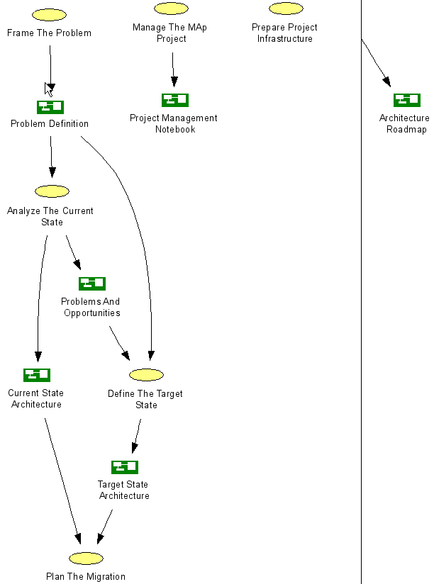
MAP “Roadmap” Route
Overall flow shown
Multiple entry points
Iterative
Incremental

Slide 23
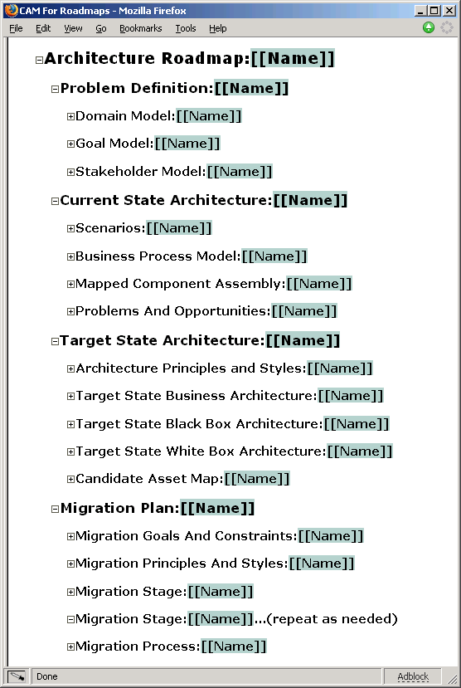
MAP Template
Overall structure shown
Model-driven
Models can be list, draft, dressed

Slide 24
Initial issues, objectives, stakeholders, etc.
buried business knowledge
refine goals and obstacles
for target state work
Frame the Problem: formalize problem, syndicate with stakeholders
Goals model Key domain terms
known reference architectures,
best practices, etc.
top-level problem definition,
domain terms to map,
priorities, focus areas
Analyze The Current State
Define The Target State
Business architecture
scenarios
sketch of processes, roles,
and activities
key information terms
problems and opportunities
Business architecture
principles and styles
processes, roles, activities
validation vs. goals and obstacles
problems and opportunities
Component architecture:
principles and styles
[black-box] top-level assembly of
[black-box] map to domain types
[black-box] context: ports, use cases
[white-box] partition and layer styles
[white-box] sub-component assembly
[white-box] end-to-end collaborations
technical properties, mapping styles
validation vs. goals and obstacles
target reference architecture
e.g. components, functions,
information … for inventory
Component architecture
application inventory and map
(against domain, target reference)
non-functional and technical props
problems and opportunities
Plan The Migration
relationship to other roadmaps and projects
goals, constraints, architectural sequencing dependencies
migration principles, stages: evolving architecture snapshots with gaps,cost
cross-project
“program” conformance
project funding
project requirements
project funding
project requirements
project funding
project requirements

Slide 25
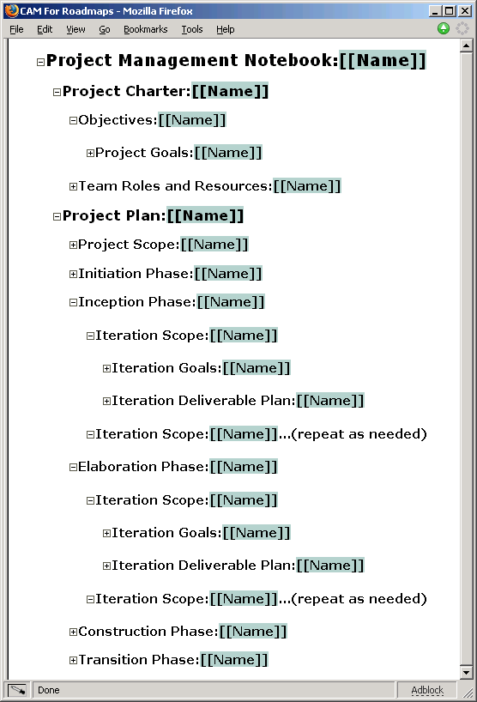
MAP Planning
Iterative, not waterfall
Emphasis shifts across phases
List → draft → dressed artifacts
High-risk items in early iteration

Slide 26
Migrating to MAP
MAP can be applied as rigorously or lightly as appropriate
The underlying concepts of MAP are few and simple
Applying it effectively takes a focused mindset
Classic migration path …
Unconscious Ease
Having an easy time without conscious effort
Conscious Ease
Having an easier time with conscious effort
Conscious Difficulty
Having a hard time and do know it
Unconscious Difficulty
Having a hard time and don’t know it

Slide 27
Exercise 2

Slide 28
Outline
Introduction to MAP: What it is, Process and Artifacts
Models, Architecture, and Objects
Goals and Domain Model
Current State Architecture
Target State Architecture
Migration Plan
Project Management

Slide 29
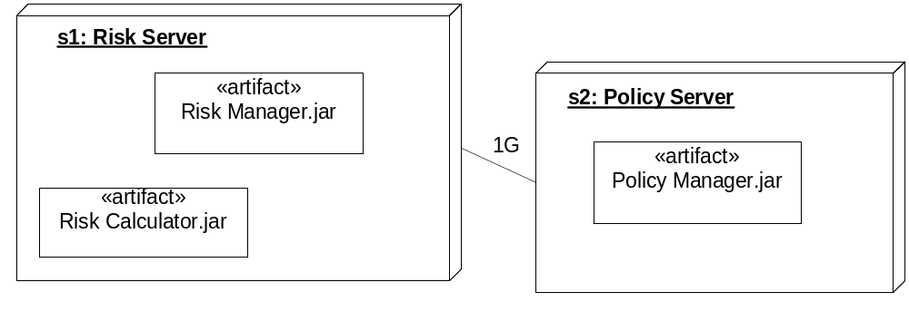
What is a Model?
Nodes
s1: Risk Server
s2: Policy Server
Artifacts
Risk Manager.jar s1
Risk Calculator.jar s1
Policy Manager.jar s2
Links
s1:s2 1G
Model: A structured description of selected properties of a domain or system, using some combination of textual or graphical formal language with informal natural language
There can be more than one notation for the same abstract language
  Nodes have
    artifacts deployed on them
    communication links with bandwidth

Slide 30
Observations about Models
Model ≠ Picture
  Structured text, tabular presentations very common and very useful
Models include formal, semi-formal, and informal pictures, text, …
The model can exist in many forms:
  paper and pencil
  a modeling tool artifact
  a word processor or xml document
  a white board
  spoken words
  in someone’s head (a bit of a stretch!)
We specifically want models to progress through:
  List: bulleted lists of names, optionally with nested bullets for properties
  Draft: tabular information with name + description of each element
  Dressed: full diagrams with accompanying narrative text

Slide 31
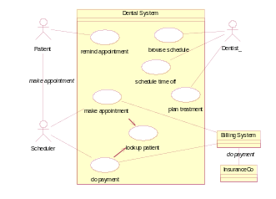
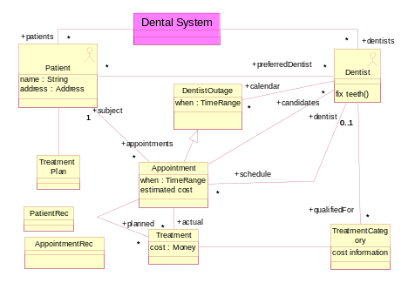
List, Draft, and Dressed Versions
_{Fully Dressed Version}
Spec
1. Business Architecture | Business perspective on the problem, including activities, interactions, and business information.
2. Component Architecture – Black Box - White Box | Describes one (or more) large grained software components as a black box, with its relation with others in its environment, including its behavior and information responsibility.
 | Designs the “insides” of each black box software component as a collection of sub-components, specifies each one, and decides how they collaborate to fulfill black box responsibilities.
4. Technical Architecture | Designs the connectors between the components to support their designed interactions, the platforms to support the components, mapping both to technology.
5. Deployment Architecture | Designs the hardware structure (nodes, connections, devices, …) and which deployable software units will map onto the hardware to support component execution and communication.
6. Module Architecture | Designs the deployable compiled software units, and how they are generated from structured source units, that are in turn determined from the application and technical architecture.
Use case: make appointment
Actors: Scheduler, System, Billing System
Inputs: patient info, date, symptoms (from Scheduler)
insurance info (from Billing System)
Outputs: appointment info, cost, dentist (to Scheduler)
Trigger: Patient calls for appointment
Precondition: None
Postcondition: An appointment has been created for
patient with suitable dentist for date, to
cover planned treatments. Insurance and
cost estimates recorded.
_{Black}
_{box}
Use
Cases
_{List Version}
Use cases Enquire about product Place order
Terminology Customer need Product
Main (success) steps:
Patient calls Scheduler for appointment
Scheduler looks up patient with System
Scheduler enters symptoms and date
System queries insurance info from Billing System
System estimates patient cost
System provides appointment, plan, staff, insurance, cost
Scheduler discusses with patient and confirms
Alternate paths:
2. Patient not found: …
Design
use case: lookup patient
Actors: Scheduler, System
…
action: estimate patient cost
post: …
_{Draft Version}
Info
Model
Actors | Customer, Sales Agent
Use cases | Enquire about product: Goal: The system has recorded customer’s need for product. Callback has been scheduled, cross-sell analysis initiated.
 | Place Order: ….
Glossary | Customer: a legal entity who … need: the set of likely future purchases Product: A unit of sales to customer …
Depth, detail, and form to suit context
Don’t produce fully dressed all at once
Iterative MAP
Iterations within phases
Inception
Elaboration
Construction
Transition
List:
Goals
Domain
List:
Black box
White box
Initial system:
List:
technical
Release

Slide 32
What is a Domain or System?
Domain / System: Some part of the world (as-is, or could-be) relevant to understanding or solving a problem; the subject matter of our problem or goals.
The “Domain” or “System” of interest could be any of:
  A software application or suite + relevant aspects of its environment
    The Risk Management Application
  A business unit or process + relevant aspects of its environment
    The overall Risk Management process, people, organization, roles, and policies
    The crisis_management phase of the overall Risk Management process
  A technical infrastructure environment
    The Network domain of nodes, connections, routers, firewalls, zones
  A collection of components and their intra- and inter-component interactions
    How the Policy Manager, Risk Calculator, and Hedge Manager collaborate
Scope of domain (e.g. for the “projector”)
  Where: how “far out” are the things we must understand and address to meet goals
  When: which parts of the lifecycles do we care about
  What: what aspects or concerns are relevant

Slide 33
Technical Domains and Business Domains
Messaging
Business
Black Box
White Box
Message
Topic
Subscription
Queue
…
Trading
Business
Black Box
White Box
- technical
Security
Business
Black Box
White Box
Role
Authorization
Permission
Capability
Credential
…
Infrastructure or technical domains (e.g. Security, Messaging) have their own “business” or domain models, black box, and white box models
These can be developed, to some extent, in parallel with the primary business domain (e.g. Trading) … but remembering that usage defines requirements
When Trading is designed or implemented in technical or platform terms, that platform is defined by the technical domains

Slide 34
The MAP Approach To A Domain
MAP describes a domain across different architecture viewpoints and concerns
  Goals are an explicit and essential part of the architecture
  Both problem domain and solution architectures are precisely defined
Architecture styles define
  acceptable architectures
  conformance
  targets for governance
Available
Trading
Secure
Functional
Goals,
Problem Definition
Architecture Standards
Process,
Technology,
Solution Design

Slide 35
Domains Leverage Supporting Domains
One Domain uses all the knowledge of other specialized domains to:
  Define its problem: precise Security goals help define security goals of Trading
  Design its solution: standard Security services used in Trading implementation
Architecture styles and standards at different levels span domains
Some Trading goals
include security-related objectives, concepts
Role
Resource
Credential
Accessible
Standards
Within
Security Domain
Available
Security
Secure
Available
Functional
Secure
Trading
Functional
Goals,
Domain Concepts
Goals,
Domain Concepts
Standards for
Security across All Domains
Architecture Standards
Architecture Standards
Architecture Standards
Process,
Technology,
Solution Definition
Process,
Technology,
Solution Design
Trading conforms to
security standards

Slide 36
Example: MAP on SOA Domain
Concepts:
Service, Provider,
Consumer, Service Contract …
Goals: Manageable
Non-duplicative
Composable
Governable
Goals and Problem Definition
Define SOA and its goals
Clearly define SOA concepts
Solution: Processes
Define SOA processes to support goals
Solution: Technology
Design supporting technology
Define Architecture Standards
Patterns, styles, principles for SOA users
Manageable
SOA
Secure
Functional
Goals,
Problem Definition
Architecture Standards
Governance Process
Service Definition
and Publication Process
Process,
Technology,
Solution Design
Blue Titan
Amberpoint
Tibco
…
WSDL
UDDI
WSBEL

Slide 37
What is Architecture?
Architecture: An architecture of a system from a viewpoint is
  a (more or less correct) model of that system
  using the language of that viewpoint
  that describes system properties that are of concern to that viewpoint
    Properties explicitly described in the model, or
    Properties that can be objectively inferred from the model
Viewpoints are defined based on the kinds of questions they help answer
  Services: what services are provided and required? interactions?
  Deployment: where are deployable units run? what is connectivity?
  Production: how is system installed? migrated? administered?
The language is associated with the viewpoint
  So all systems’ deployment architectures are described in the same language
Viewpoint definitions should be standardized across systems
  Architecture styles take advantage of consistent viewpoint separation
Architecture captures key decisions and eliminates needless creativity in the further design, implementation, and evolution of the system

Slide 38
Objects
Objects pervade our models, but not in the sense of OO-programming
  An object is an individual thing we care about in some domain
What we model about an object depends on:
  Its nature
    Active behavioral objects: software systems, components, roles in processes
    Information objects: things stored or passed around between active objects
  Our purpose
    Are we focused on functionality?
    Security?
    Location and distribution?
    Technology choices?
    Product and tool choices?

Slide 39
Scenarios – Collaboration Diagrams
m1 (x,y)
m2 (x,z)
a: A
b: B
d: C
m3 (y)
c: C
a, b, c: objects “active” in the interaction
x, y, z: objects manipulated or passed around

Slide 40
Exercise 3

Slide 41
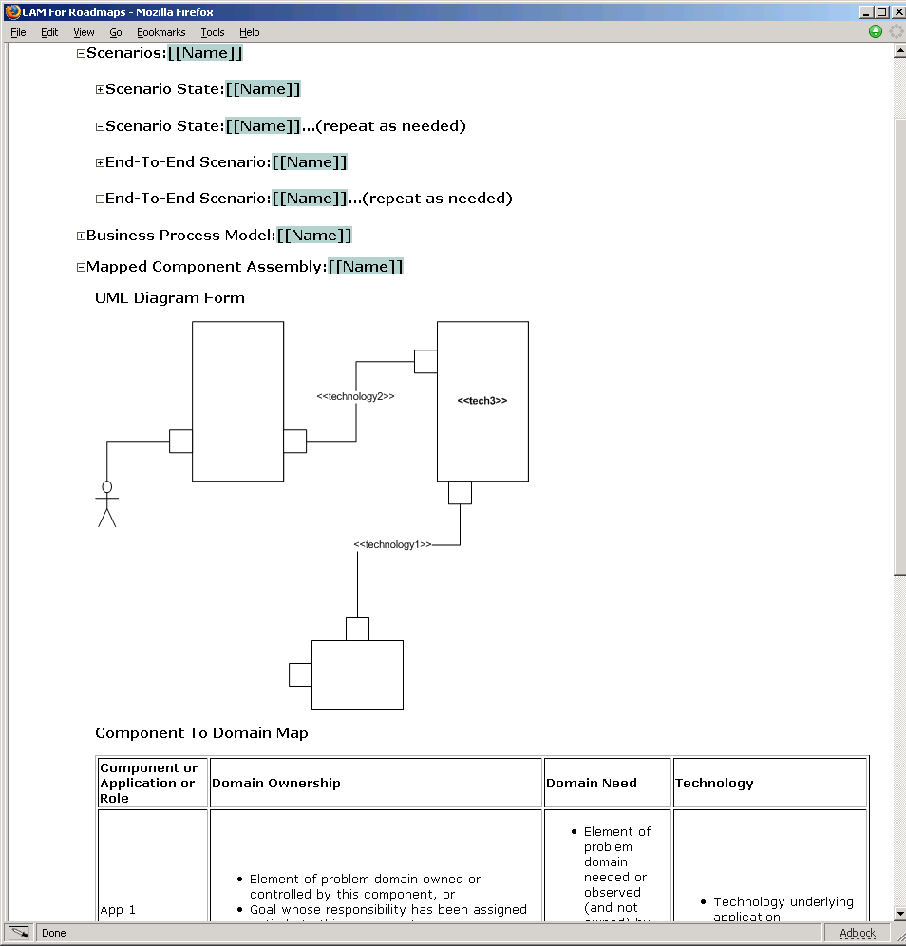
Discuss
Which parts of the MAP template have we just visited?
Would this be useful for current-state? Target state?
How would we know if we are exploring the right scenarios? Covering the right domain?

Slide 42
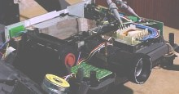
Viewpoints – What would a design review do?
Goal !
Problem Definition::
Goal +
Domain Model
Goal ?
Black-Box::
Assembly
Projector
Specification
Black-Box::
Specification (of one connector)
Black-Box::
Specification (of one box)
White-Box::
Internal Design as
assembly of smaller parts
White-Box::
Do connectors have specs?
Implementations?

Slide 43
MAP Viewpoints: An Example Close To Home
Let’s take a look at MAP applied to ID&EM

Slide 44
Outline
Introduction to MAP: What it is, Process and Artifacts
Models, Architecture, and Objects
Goals and Domain Model
Current State Architecture
Target State Architecture
Migration Plan
Project Management

Slide 45
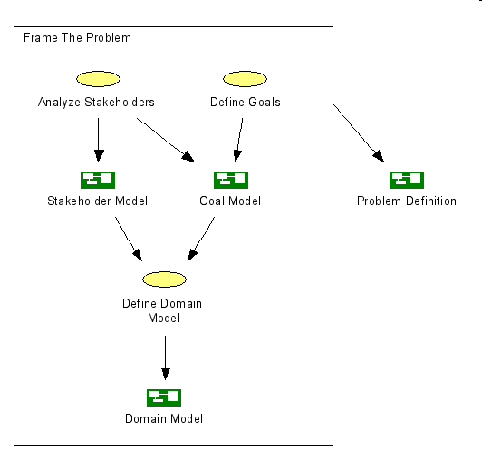
Frame The Problem

Slide 46
Main Elements of a Domain Model
A Domain Model consists primarily of a model of
  Types of objects
  Their attributes, including relationship to other objects
  Events involving those objects and attributes
  Static + Dynamic constraints on the attributes and relationships
An Information Model (types + attributes) often covers most of a Domain
  One modeling technique
    Model an event as an object
    That object only appears in one snapshot: right after the event took place
The basic approach to building an information model is
  Consider domain terms used e.g. in goals, or scenarios, or constraints
  Model those terms in the information model

Slide 47
Main Elements of Goal Modeling
Goal Model
Why goals exist
How goals are realized
Definition of each goal
Stakeholders, priorities, etc.
Alternative goal realizations
Obstacles, conflicts, resolutions
Depends on for goal
Stakeholders in Goals
Who are primary stakeholders for each goal
Responsible roles or process has access or
control of attributes and types
as needed for the assigned goals
Some form of accountability
All important terms used in goals
are captured in Information Model
Responsibility Assignment
Which human / hardware / software / process is responsible for goal
Can explore alternate responsibility assignments
Domain/Information Model
Objects, attributes, etc.
The things that would appear on an “executive dashboard” that monitored goal-oriented performance
Light weight “List” and “Draft” versions are equally useful

Slide 48
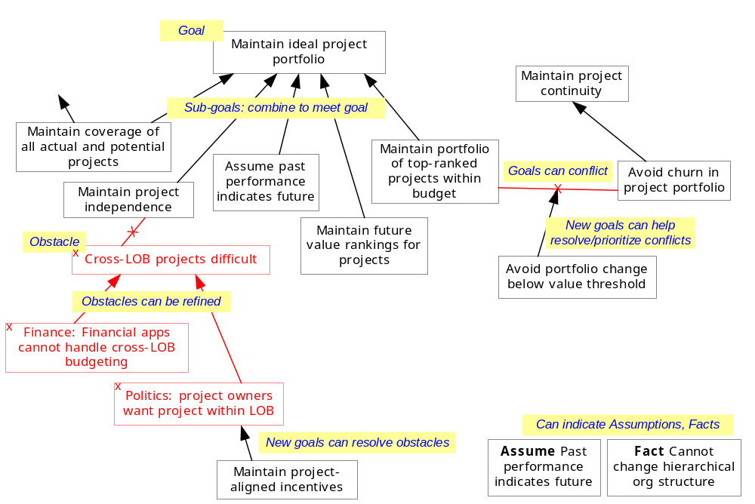
A Goals Model
Why
stakeholders, definitions, domain/information model
How

Slide 49
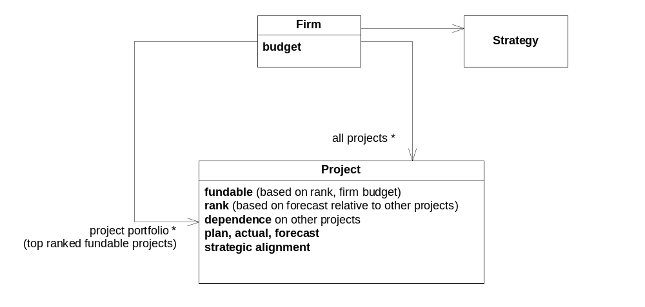
Goals and Domain Model
Goal Maintain ideal project portfolio level
At all times maintain the firm’s top ranked fundable projects within the project portfolio. Rank is based on
forecast program value, from plan, actual, and forecast of all projects
it’s overall alignment with firm strategy
it’s minimal dependence on other projects
Goals become clearer and fewer, goal structure better motivated

Slide 50
Why–How, Obstacles, and Domain Model of Projector

Slide 51
Exercise 4

Slide 52
From Goals to Top Level Components, Connectors
Each Goal refers to certain elements of the Information Model
  Manage Portfolio: Constantly evolve the portfolio of products to optimally meet customer need
Some of these elements are controlled, others are observed
  customer need - observed
  portfolio – controlled
These elements may be owned elsewhere in the enterprise
  customer need – owed by Application-1
  portfolio - owned by Application-2
Essential connectivity between components spelled out by goal itself
Manage
Portfolio
customer need
portfolio

Slide 53
Goals Drive Other Architecture Decisions
Goals modeling drives out other goals, assumptions
  Constantly evolve the portfolio of products to optimally meet customer need
  Why? → higher level goal: provide optimally aligned customer-experience
  How? → evolving portfolio of products is not itself sufficient to meet higher goal
Goals drive the top level architecture choices, alternatives, refinements
  What is the essential connectivity between top-level black boxes?
  What changes to components and connectors help meet the goals?
Goals drive the broad structure and detailed specification of processes
  What should be essential processes themselves?
  What should be the top-level boundary of each process?
  What should be the top-level interactions between those processes?
  What are the essential activities within each process?
  What are the specifications of each activity i.e. when triggered, prohibited, etc.

Slide 54
Clarified Goals lead to Better Architectures
What constitutes “Customer Need”?
  What are different roles a customer plays?
  How do they contribute to his/her needs?
  What different roles other objects related to Customer play?
  How do those contribute to Customer’s need?
Customer
need = ??
Role 1
Role 2
Customer’s Daughter
college plans?
Customer’s Father

Slide 55
Domains to Architecture
These are models of the Problem Domain itself
  Not necessarily of any existing piece of software
  Perhaps not directly of any to-be piece of software
  Help understand what things in domain should be monitored, controlled
  And, by refinement and architecture styles … what processes? Technologies?
Domain Architecture: better coverage of need-related information
Technical architecture: collect, correlate multiple sources of information
daughter
??
father
??
Manage
Portfolio
??
Our version of
customer need
portfolio
“Real”
customer need

Slide 56
Outline
Introduction to MAP: What it is, Process and Artifacts
Models, Architecture, and Objects
Goals and Domain Model
Current State Architecture
Target State Architecture
Migration Plan
Project Management

Slide 57
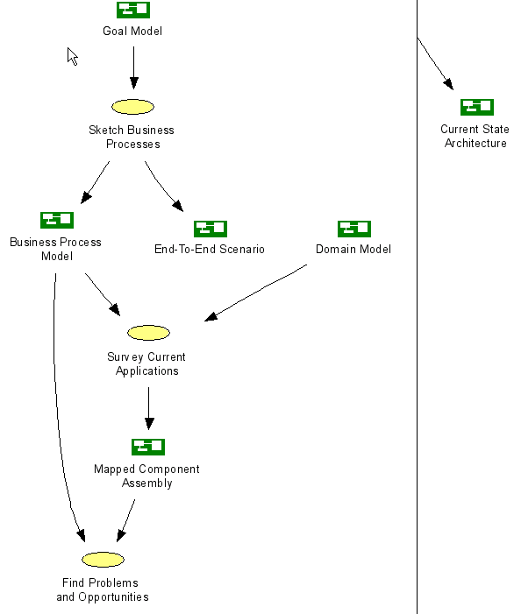
Current State
Focus scoped by problem defn.
Map applications to domain model
Feed back obstacles to problem definition
Feed forward both problems and opportunities to target state definition

Slide 58
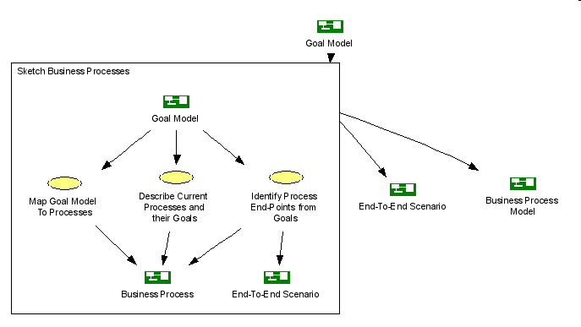
Sketching Business Processes
Identify Process End-Points From Goals
  Process (and illustrative scenarios) should span all elements relevant to goal

Slide 59
Finding Scenarios for a Goal
A goal refers to certain elements (attributes, events, etc.) of the domain
Hence certain events in the domain could cause the goal to be violated
  Changes in observed attributes
  Explicit request events
We want to identify such events from the goal and domain definition
  Part of our architecture will need to detect these events
  Other parts will need to collaboratively react to these events
These help us find scenarios to use to validate our architecture

Slide 60
End-To-End Scenarios from Goals: for Projector

Slide 61
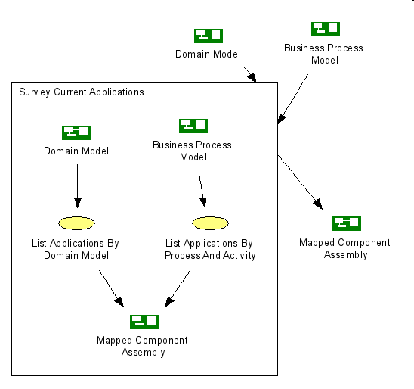
Survey Current Applications
Map applications (and roles) to their coverage of the domain model

Slide 62
Mapped Components
Application | Domain Element Owned | Domain Element Needed | Technology
App1 | Type or Attribute or Event (or Goal) | Type or Attribute or Event (or Goal)
App2 | …
If there is no clean allocation of ownership for some domain element:
  Try refining it into finer-grained elements that have clear ownership
  e.g. Gasoline station: sales transactions owned by pump and by station computer
    Owned by pump during the filling
    Owned by station computer after completion of filling

Slide 63
Exercise 5

Slide 64
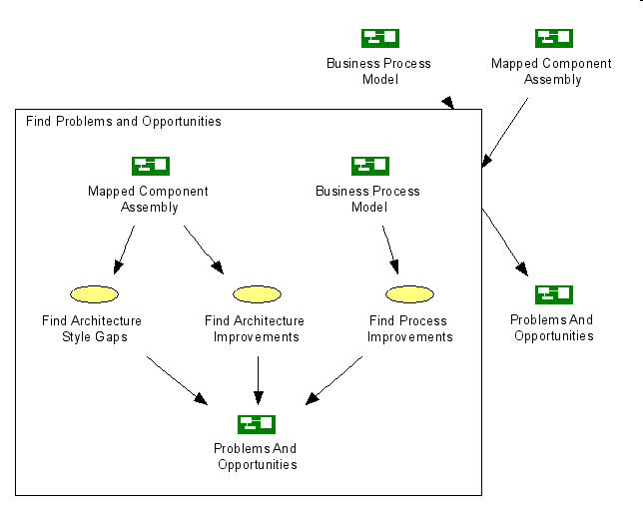
Find Problems and Opportunities

Slide 65
Problems and Opportunities: Projector
Assume that live meetings using projectors are the current state. Let’s come up with likely current-state problems and improvements in:
  Business process
  Software architecture
Pick one current-state problem. Model it as an obstacle to some goals.

Slide 66
Outline
Introduction to MAP: What it is, Process and Artifacts
Models, Architecture, and Objects
Goals and Domain Model
Current State Architecture
Target State Architecture
Migration Plan
Project Management

Slide 67
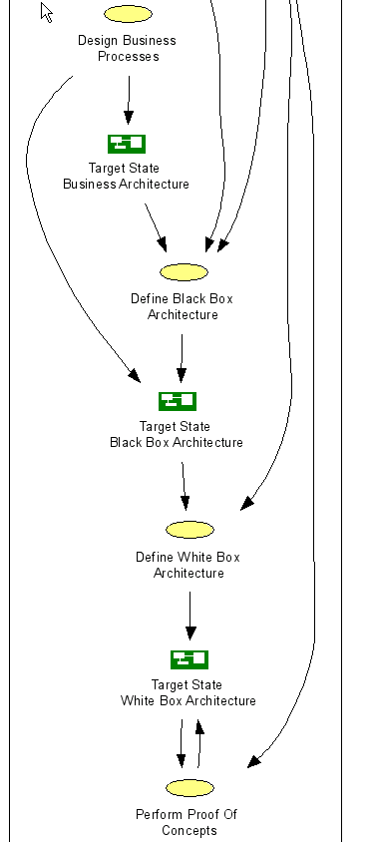
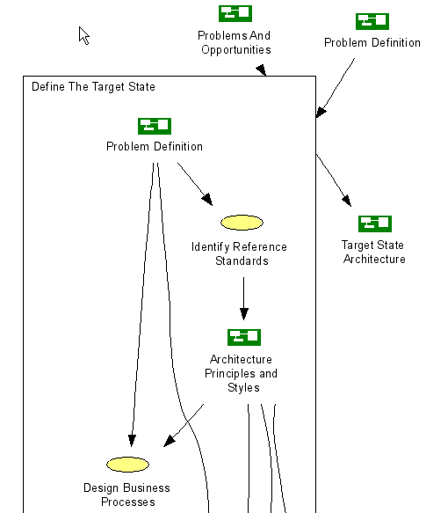
Target State: Process
Establish architecture styles for goals
Design ideal business processes for goals
Identify black-box partition and assembly
Design internal white-box assemblies
Choose candidate products for POCs

Slide 68
What is an Architecture Style?
Architecture Style: A definition of which architectures are acceptable (or preferred), within or across viewpoints, in the context of goals and constraints, including a possibly customized language with new element types and rules of usage.
Possible usage includes
  MDA-style transformation
  design patterns
  principles
  shared code components
Style | Example | Generative | Automated | Checkable
Guidelines and patterns for the architect to follow | If high availability is needed use replication and heartbeats | X | - | X
A generator or transformer across architecture viewpoints | Generate EJB deployment descriptors, database schemas from source model | X | X | X
A predicate to use to check if an architecture is acceptable | Component count should be constant or increase very slowly with increase of users | - | - | X

Slide 69
Architecture Principles and Styles
Architecture principles and styles define preferred architectures
Very wide spectrum of styles in all viewpoints
  Earliest point of data capture: capture data at earliest point in a process
  Workflow coordinator style: partition components and co-ordinate flows
  Coexistence Bridge: replacement and legacy apps coexist using replication
  Replication and heartbeats styles: maintain availability through failures

Slide 70
Style: Basic Workflow
= component corresponding to an activity in the lifecycle of some object
Manager
= workflow manager for object lifecycle
= event from component to / from workflow manager
= “virtual” connector between components, represented explicitly in workflow manager.
Connector variations include constructs for loops, sequence, conditions, forks, joins, …
Black-Box Boundary for Workflow Style
Manager
Input architecture: pattern, assumptions …
Output architecture: patterns, …
Resulting architectural properties …

Slide 71
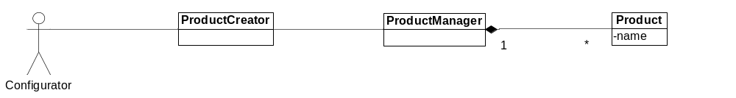
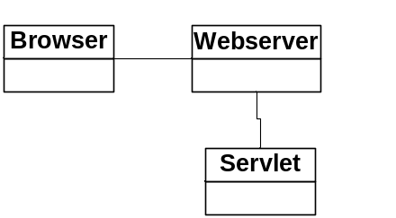
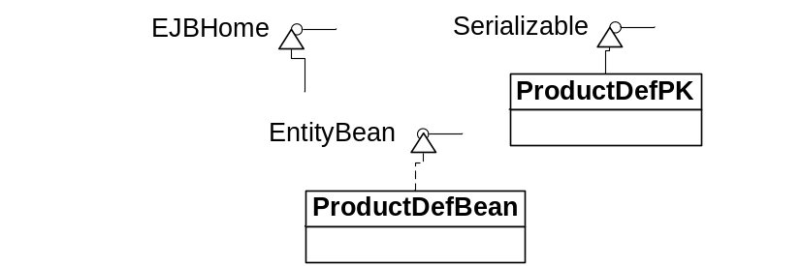
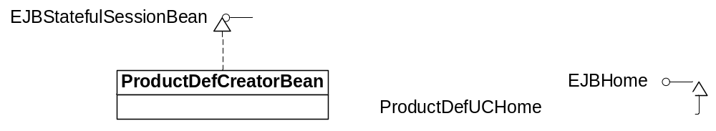
Style: Map Components/Connectors to J2EE
<<http>
<<ejb-session>
<<ejb-entity>>
HTTP Connector Style
EJB Implementation Style
EJB Persistence Style
Can define patterns to map to platform supported architecture
  EJB Session beans (stateful for dialog; preferably stateless for server)
  EJB Entity beans
  Servelets and JSPs

Slide 72
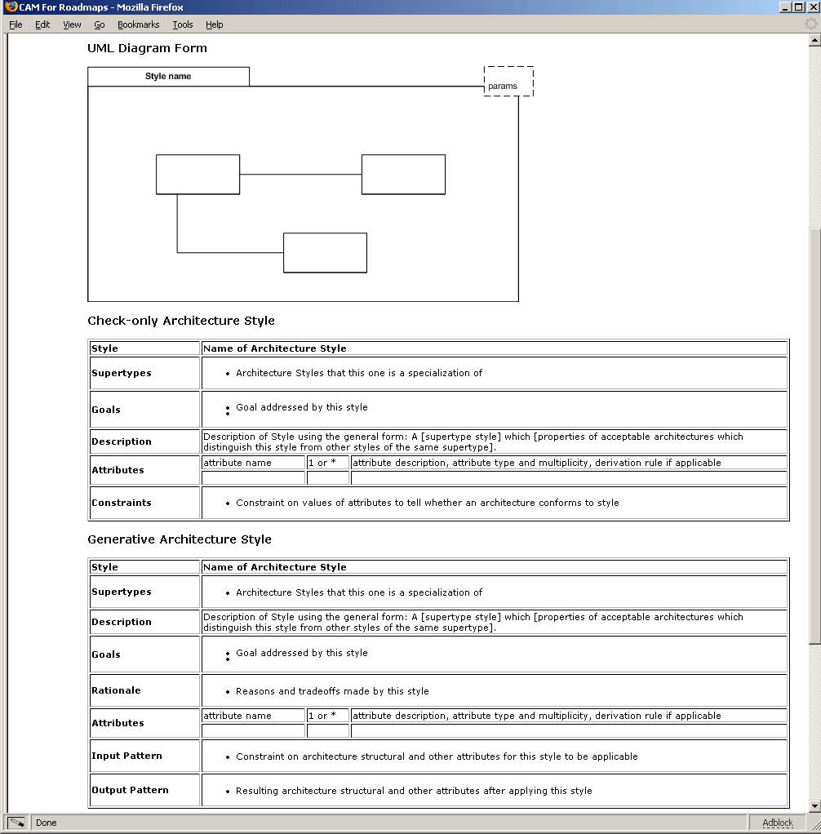
Styles

Slide 73
How do goals drive Business Processes?
Business process should have an objectively determined boundary
Required process interactions and activities are determined by goals

Slide 74
Target State Processes: Case, Coordination, and Strategy
Identify long-lived client-facing Unit Of Work (customer-aligned process)
  e.g. Presentation
Ask the question: “Is This an Essential Business Entity”?
  Test: eliminating it is not an option in your business
Define “case” process: takes one instance through its lifecycle
  e.g. Make Presentation
Find “generates” relations to other entities spawned off, with their own lifecycles
  e.g. Question
Define “case” process: takes one instance through its lifecycle
  e.g. Take Question
Define “case coordination” process to start, stop, coordinate multiple “cases”
  e.g. Coordinate Questions, Coordinate Presentations
Case coordination process does not have to be stand-alone
  It could be a part of some larger case process
  e.g. Make Presentation could include the coordination across all its Take Questions
Define dynamic relationships between Process instances

Slide 75
Refining Goals and Business Process Design
“Essential” entities with interesting lifecycles in Presentation domain
  Presentation, Question, …
Corresponding reference processes
  Make Presentation, Take Question
  Coordinate Presentations, Coordinate Questions
  Presentations Strategy, Questions Strategy
Reference process architecture ties these together
  Arrows do not imply sequence, but summarize inter-process interactions at lower level
monitor, improve
Presentation
Strategy
monitor, improve
Maintain Patient
start,
stop,
allocate room
Make Presentation
Coordinate
Presentations
deliver resolution
question request
Coordinate Breaks
start,
stop,
redo
Maintain Patient
Take Break
Maintain Patient
new question,
related questions
Take Question
Coordinate
Questions

Slide 76
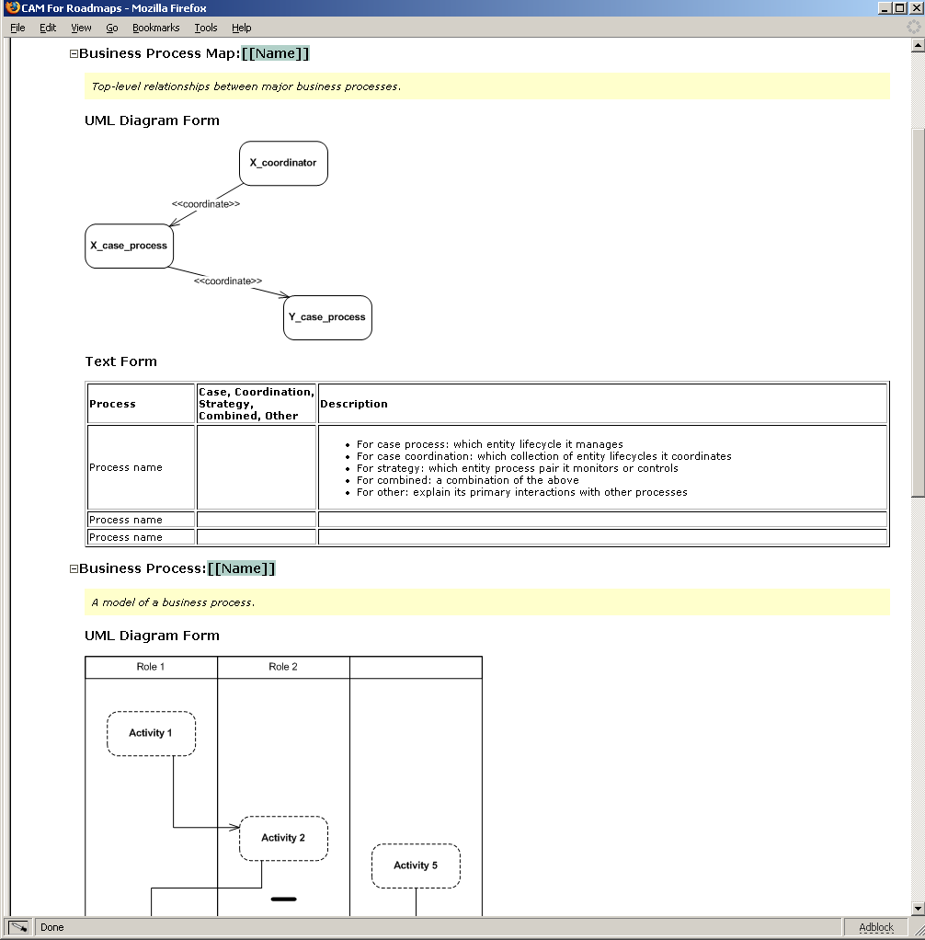

Slide 77
Discuss
Case and Co-ordination processes for case study

Slide 78
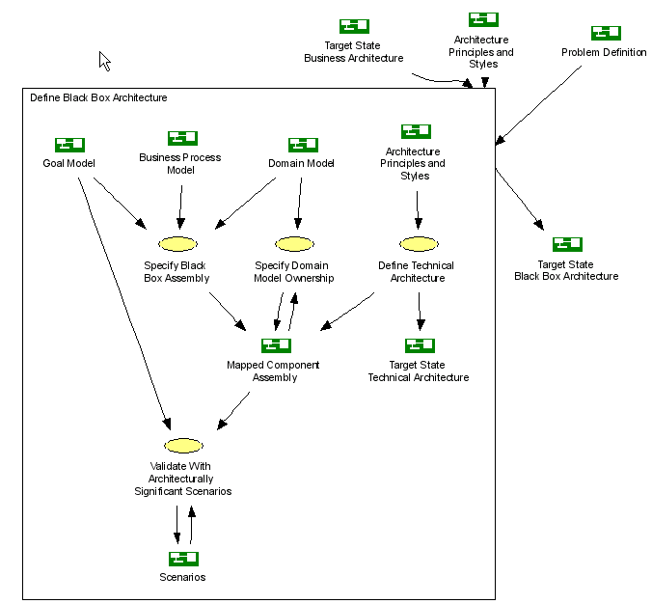
Black-Box
Choose top-level assembly of black-boxes and roles, using:
  Goals
  Domain model
  Styles
Map to domain model
Validate with goal-based end-to-end scenarios

Slide 79
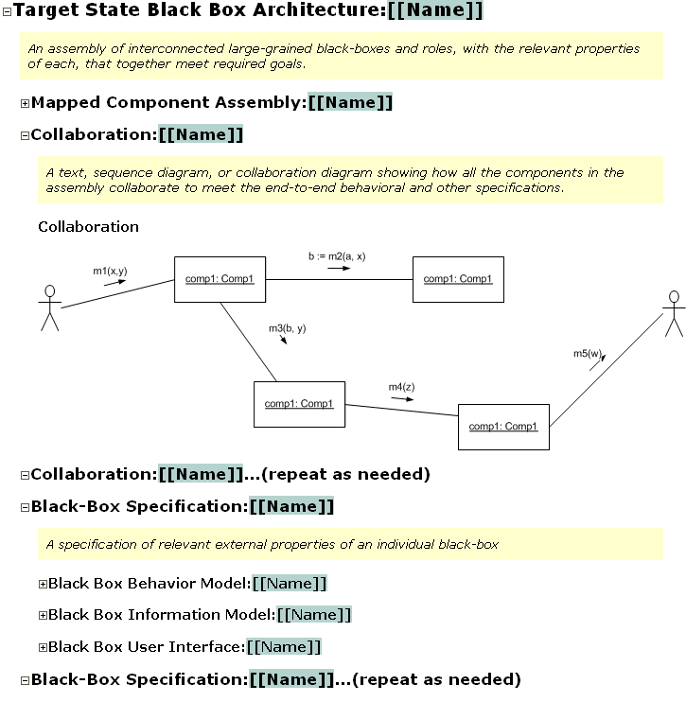
Template

Slide 80
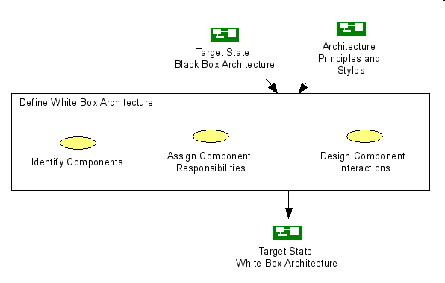
White-Box
White box partition driven by styles
Produces component assembly
Validate by scenarios

Slide 81
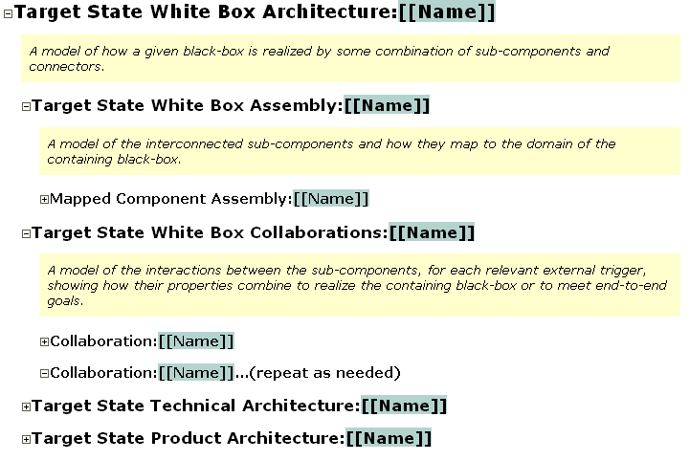
Template

Slide 82
Outline
Introduction to MAP: What it is, Process and Artifacts
Models, Architecture, and Objects
Goals and Domain Model
Current State Architecture
Target State Architecture
Migration Plan
Project Management

Slide 83
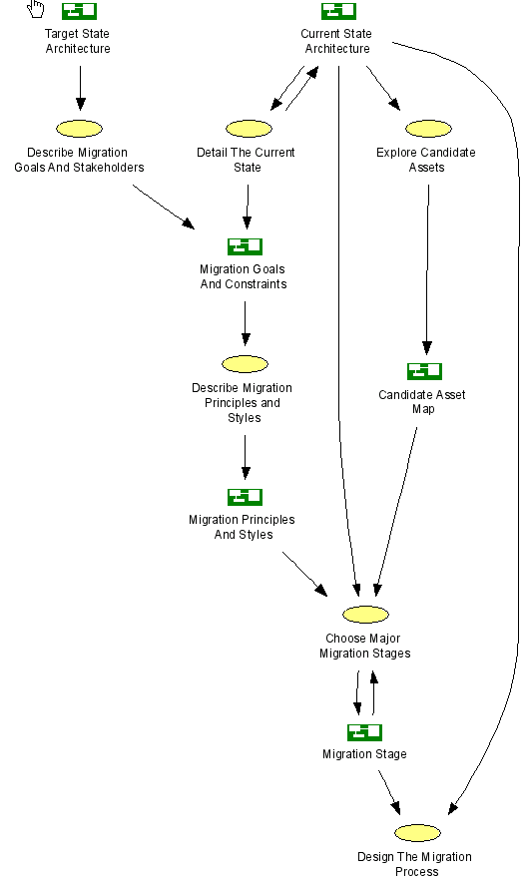
For complex migrations:
  Treat migration as miniature problem domain itself
  Model migration-oriented goals and stakeholders
  Define styles to guide migration design
  Find candidate components or products to use
  Choose stages (snapshots of architecture) for value and cost
  Design detailed process to syndicate to stakeholders

Slide 84

Road Maps and Migration Planning
MAP can describe architectures at a variable level of precision
MAP viewpoints apply to architecture migration plan
Stage Name | Current State | Interim 1 | Interim 2 | Target State
Stage Date | Feb 2002 | Nov 2002 | Sep 2003
Stage Description | … | … | … | … including Target architecture style
Logical Assembly Connected components, optional key interactions, business processes
Technical Architecture
Changes, Gaps, Training required
Costs, benefits, risks, rationale
Conformance to Target state architecture style

Slide 85
Relating Roadmap to other Roadmaps
Goal + domain model
(parent)
Parent
Common approach for 2 kinds of relationships
  Child roadmaps
  Peer roadmaps
Child roadmaps (e.g. ID&EM and ER)
  Child roadmap mostly details the goals, white-box architecture, migration of parent
  Need clear consistency relationship between the two, even if not enforced 100%
  Child roadmaps may be focused on a sub-component, or a slice through all sub-components
Ownership: parent roadmap owns child’s interfaces, connections, cross-child domain model, architecture styles
Coverage: parent must explore “architecturally significant” sub-goals scenarios
  Scenarios must begin and end at the “end-points” of the outermost parent goals
  Must include scenarios that exercise new paths through the next level architecture
  Must include scenarios that cannot be localized within a single child
Peer roadmaps (e.g. ID&EM and HR)
  Demands communication with different stakeholder and owner group
  Goals and information models must fit together for overall goal
  Component architecture, information ownership, interaction must fit together
  Migration plans and timelines must fit
  Note: Peer roadmaps should also have a notional “parent” to own the connections

Slide 86
Outline
Introduction to MAP: What it is, Process and Artifacts
Models, Architecture, and Objects
Goals and Domain Model
Current State Architecture
Target State Architecture
Migration Plan
Project Management (not the focus of this course)

Slide 87
Architecture Viewpoint ≠ Development Sequence
Time
Waterfall
1. Business Architecture | Business perspective on the problem, including activities, interactions, and business information.
2. Component Architecture – Black Box - White Box | Describes one (or more) large grained software components as a black box, with its relation with others in its environment, including its behavior and information responsibility.
 | Designs the “insides” of each black box software component as a collection of sub-components, specifies each one, and decides how they collaborate to fulfill black box responsibilities.
4. Technical Architecture | Designs the connectors between the components to support their designed interactions, the platforms to support the components, mapping both to technology.
5. Deployment Architecture | Designs the hardware structure (nodes, connections, devices, …) and which deployable software units will map onto the hardware to support component execution and communication.
6. Module Architecture | Designs the deployable compiled software units, and how they are generated from structured source units, that are in turn determined from the application and technical architecture.
Iterative
1. Business Architecture | Business perspective on the problem, including activities, interactions, and business information.
2. Component Architecture – Black Box - White Box | Describes one (or more) large grained software components as a black box, with its relation with others in its environment, including its behavior and information responsibility.
 | Designs the “insides” of each black box software component as a collection of sub-components, specifies each one, and decides how they collaborate to fulfill black box responsibilities.
4. Technical Architecture | Designs the connectors between the components to support their designed interactions, the platforms to support the components, mapping both to technology.
5. Deployment Architecture | Designs the hardware structure (nodes, connections, devices, …) and which deployable software units will map onto the hardware to support component execution and communication.
6. Module Architecture | Designs the deployable compiled software units, and how they are generated from structured source units, that are in turn determined from the application and technical architecture.
Time
Development often should not be waterfall i.e. not 1-viewpoint at a time
Each iteration can cover multiple viewpoints
Same deliverables is refined across iterations
Each iteration balances project risk and delivering early value

Slide 88
The Role of Portfolio Management
Portfolio
Management
Assets:
Projects:
Ideas:
Tech watch:
Revenue:
Costs:
Benefits:
History:
Forecast:
Problems:
MAP
(on Roadmap)
Target State
+
Migration Plan
Project
Inception → Transition
Project
Inception → Transition
Project
Inception → Transition
start
stop
resource-allocate
Production
Monitoring
Controlling
Improving
Retiring
Other Enterprise Modeling Activities
(cross project, cross business)
So early MAP activity (e.g. Initiation Phase) corresponds to Portfolio Management activities

Slide 89
Defining Migration Stages
Interim Day2, Jan 2006
- All connections have been either …
B
Stage Name
Date
Summary description
White box component assembly
  Optional: key collaborations
Product/technical overlay (overlay terms defined in Styles)
The main changes from the previous stage
For each target-state architecture principle or style
  How well does this stage conform or not conform, and why
For each leaf-level target-state business goal
  How well does this stage meet that business goal, and why
Rationale for this stage
Cost of getting to this stage
Benefits and risks of this stage
<<nightly batch file>>
A
<<manual>>
C
<<oracle>>

Slide 90
Architecture Sliced By Project Lifecycle
MAP architecture viewpoints apply to different Project Lifecycles
MAP deliverables are adapted to lifecycle
  “List” vs. “Draft” vs. “Dressed” versions
  As-is vs. To-be models
Cycle 1 Cycle 2 Cycle 3
Business list draft dressed
Black box list draft dressed
White box list draft
RUP-like Lifecycle
Iterations within phases
Inception
Elaboration
Construction
Transition
goal1
goal2
goal3
Release

Slide 91
Detailing Migration Plans to Project Plans
Projects produce much more detailed descriptions than migration plans
Detailed specifications and internal designs of components
Styles of mapping components, connectors to platforms
  Usage patterns and guidelines from logical architecture to platform facilities
Incremental delivery
  Typically scoped by use cases delivered in an increment
Parallel work plans and dependency management
  Share the portions of models e.g. overlapping business domains
  Separate business and technical domains e.g. trade capture vs. security services
  Continue to use external views of components versus their internal implementations
Candidate components
  Include your current state components in your application inventory
  Consider finer-grained partitions of your current components that might be harvested and re-packaged for use
  Include candidate third-party components, applications, and frameworks (both business and technical)
If roadmap-scale effort leads to other roadmaps, MAP provides further guidance

